Slide 1


ايذاء الاخرين لفظيآ
Cyberbullying Detection
By:
John Hani
Mohamed Nashaat
Mostafa Ahmed
Zeyad Emad (Team Leader)
Under supervision of :
Dr. Eslam Amer, Dr.Ammar
Eng. Menna Gamil
Date:4\2\2019

Slide 2
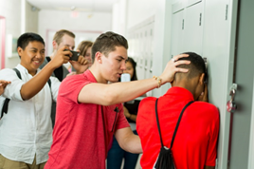
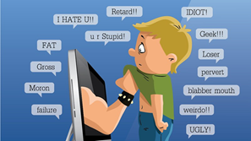
Introduction
Use superior strength or influence to intimidate someone
Cyberbullying has been manifesting our youth for quite some time, due to them being involved in one form of social media communication or another.
Our Scope
Social Media platforms will benefit from our software as cyberbullying rates will drop
Real life
The Internet

Slide 3
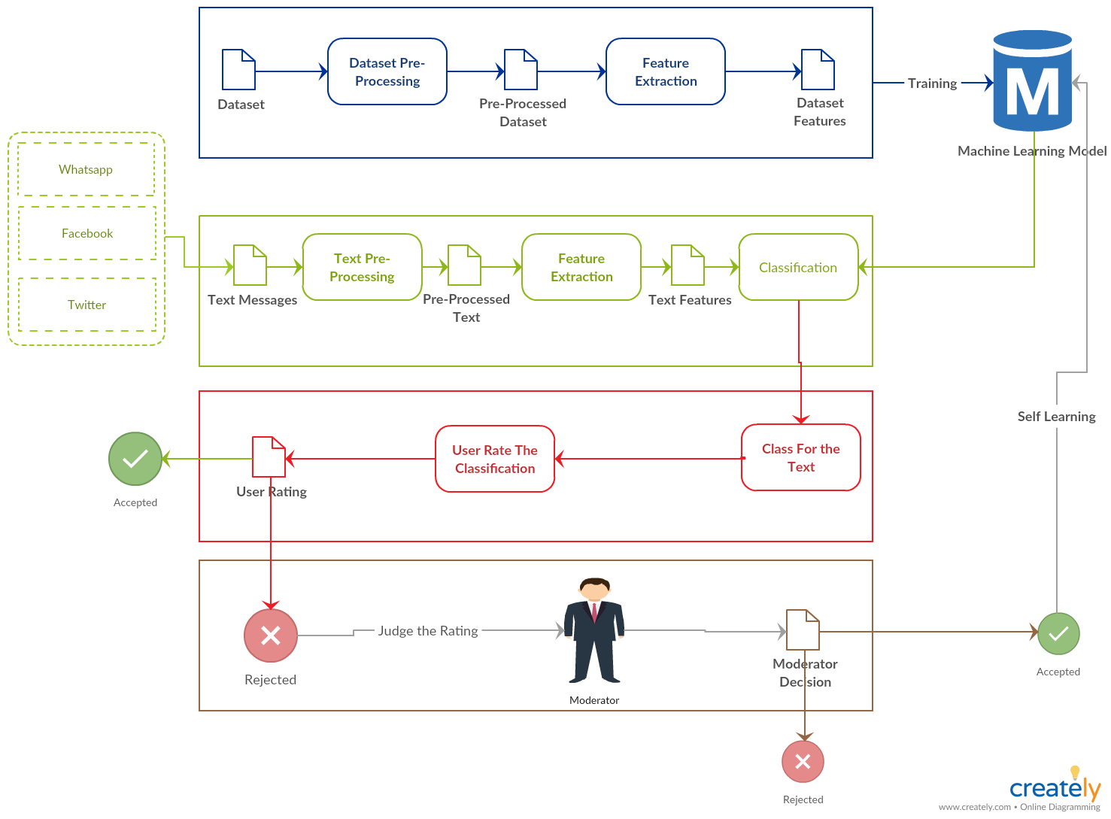
System overview

Slide 4
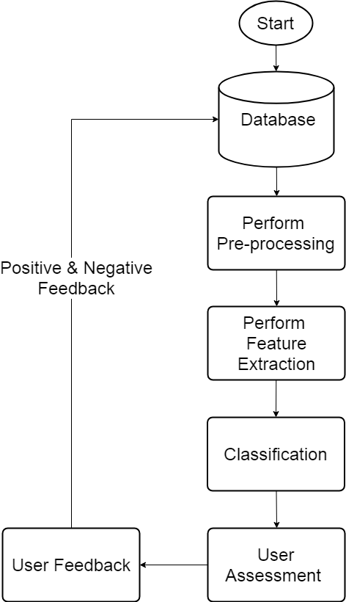
Activity diagram

Slide 5

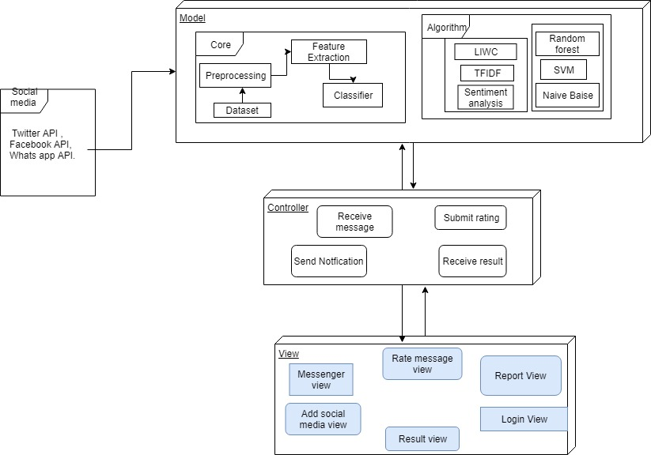
System Architecture
Feature
Extraction
Classifiers

Slide 6
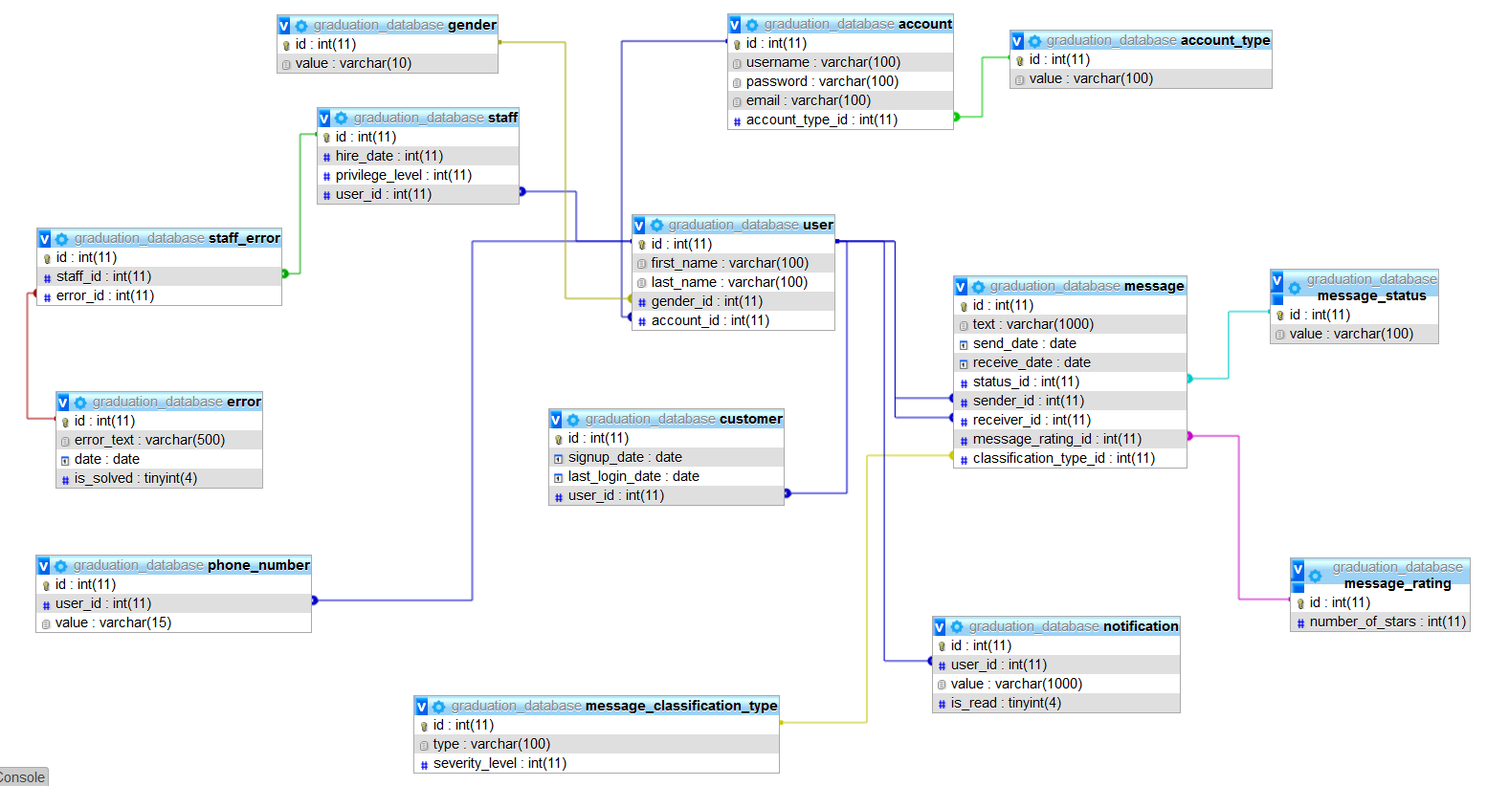
Database

Slide 7
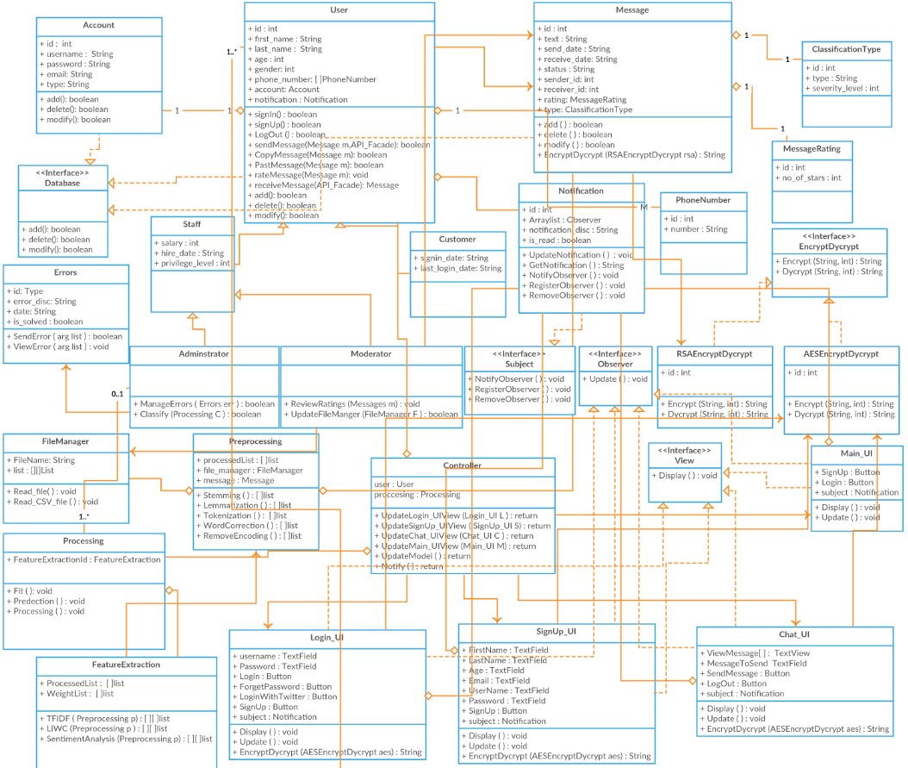
MVC Design Pattern

Slide 8
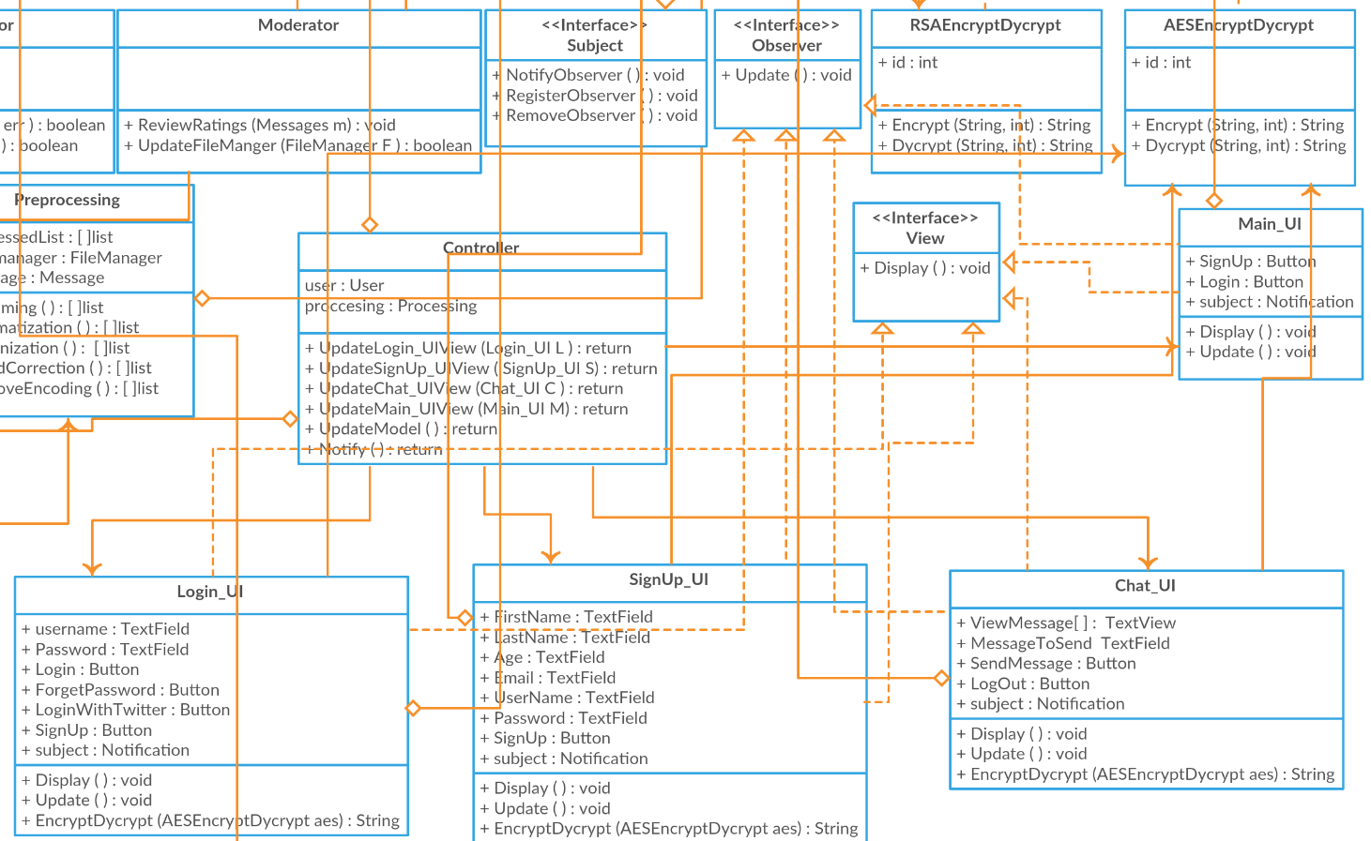
Observer Design Pattern

Slide 9
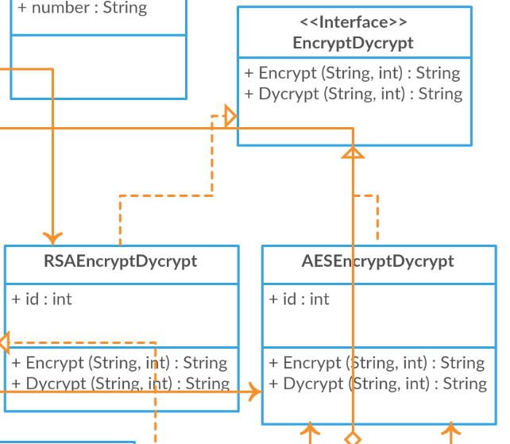
Strategy Design Pattern

Slide 10
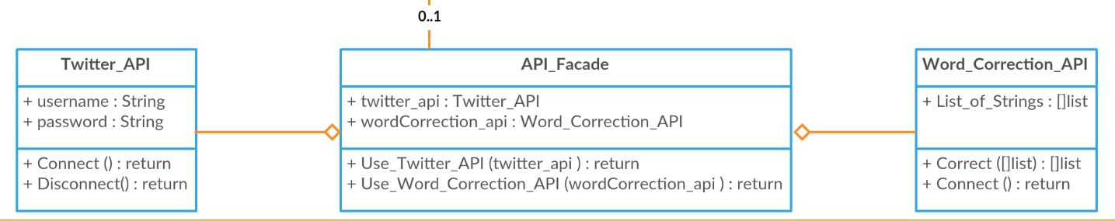
Facade Design Pattern

Slide 11
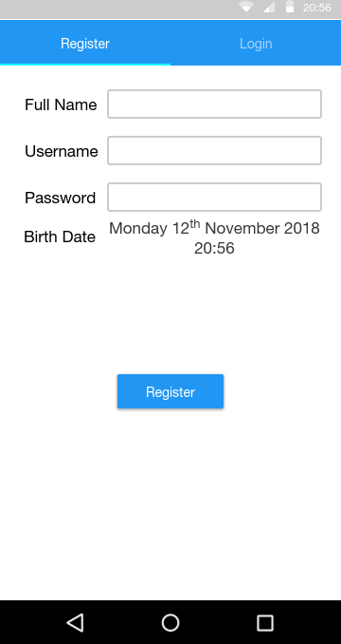
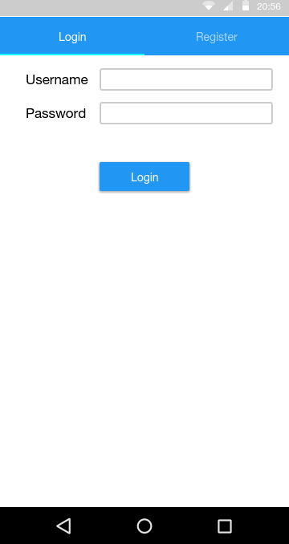
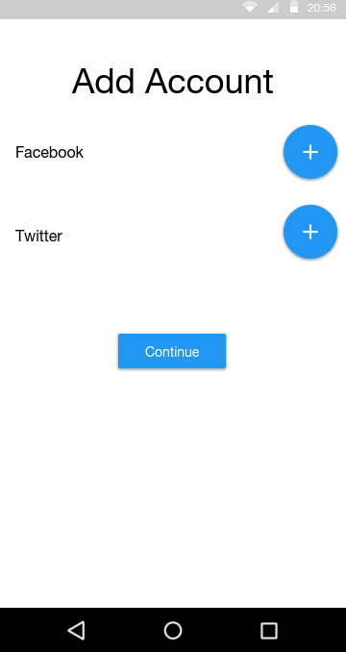
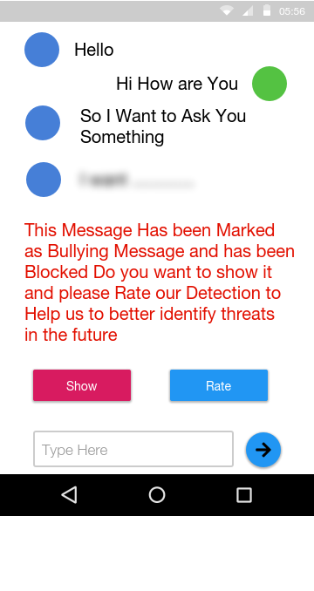
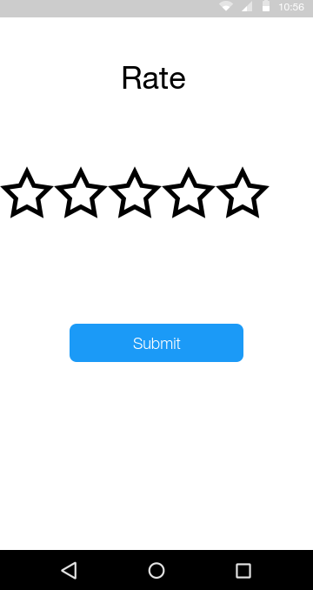
GUI

Slide 12
Design Rationale
Bag of words
Bag of word models don’t respect semantics of the word.
KNN
must compute the distance and sort all the training data at each prediction, which can be slow if there are a large number of training examples
And it is robust to noisy data.
.
Skip gram
Failed to identify the combined word phrases and the different meanings of the same word because it is represented with one vector. Also Failed to identify the combined word phrases.
N-gram
it can only interpret unseen instances with respect to learned training data. That is, if a classifier learned from the instances 'today was a good day' and 'that is a ridiculous thing to say', it is unable to say much about the instance 'i love this song!' since the features are 'today', 'was', 'a', 'good', 'day', 'that', 'is', 'ridiculous', 'thing', 'to', 'say'.

Slide 13
What we have used
TFIDF
Construct weight Vector for the sentence based of the fitted Vocabulary from the dataset
Sentiment analysis
Calculate the Total Polarity of the Sentence
SVM
Used to classify the Messages received from the Social Media Recieves the vector Resulted from TF-IDF and the polarities from the Sentiment analysis

Slide 14
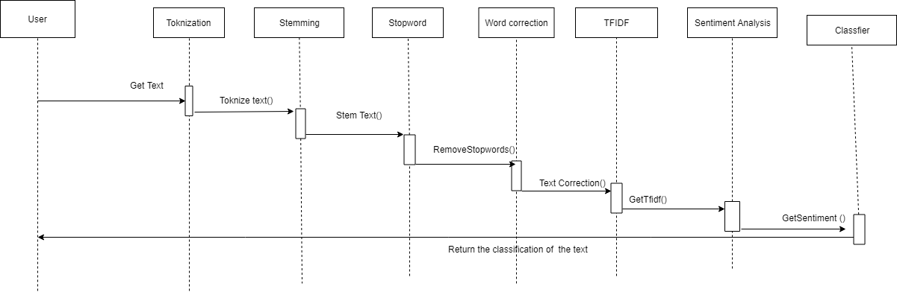
Sequence diagram

Slide 15
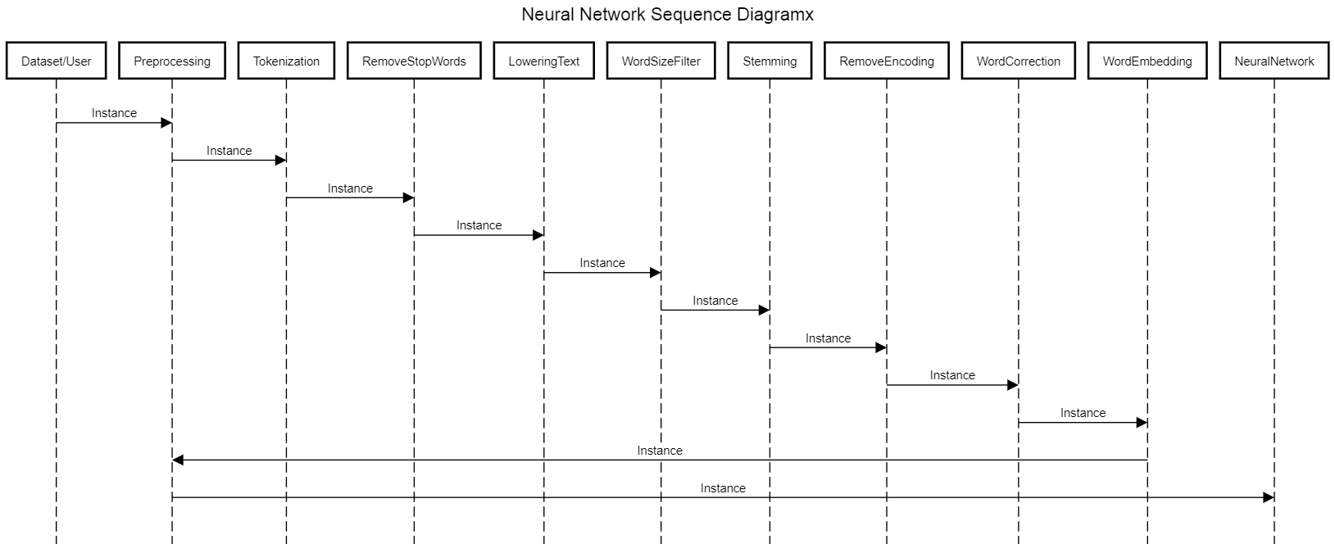
Sequence diagram

Slide 16
Demo

Slide 17
Any Questions ?

Slide 18
Appendix

Slide 19
Most Important Algorithm
Sentiment Analysis
What is Sentiment Analysis ?
Why we chose it ?
How it works ?

Slide 20
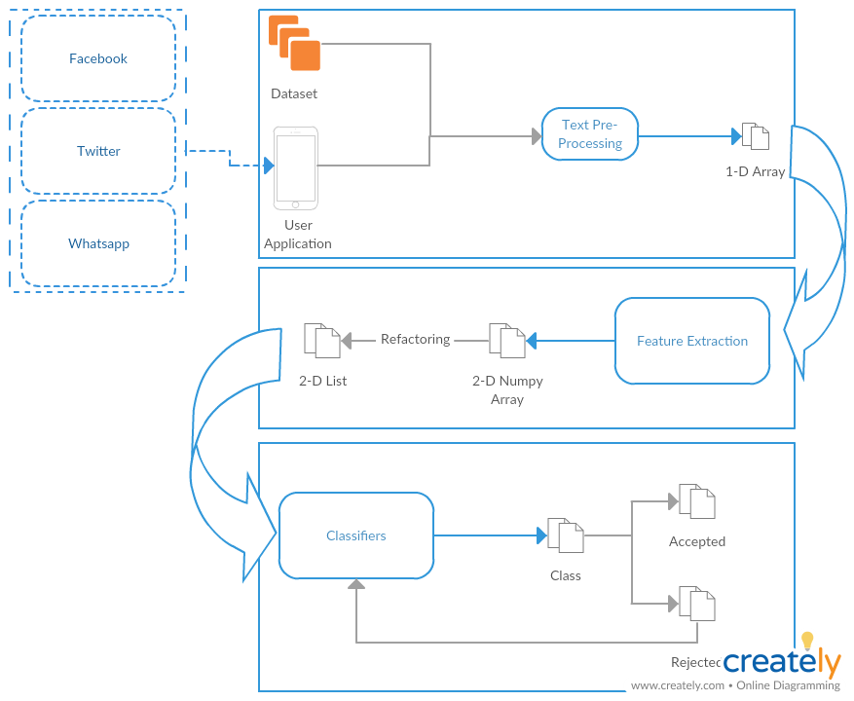
Business Model
Self Learning

Slide 21
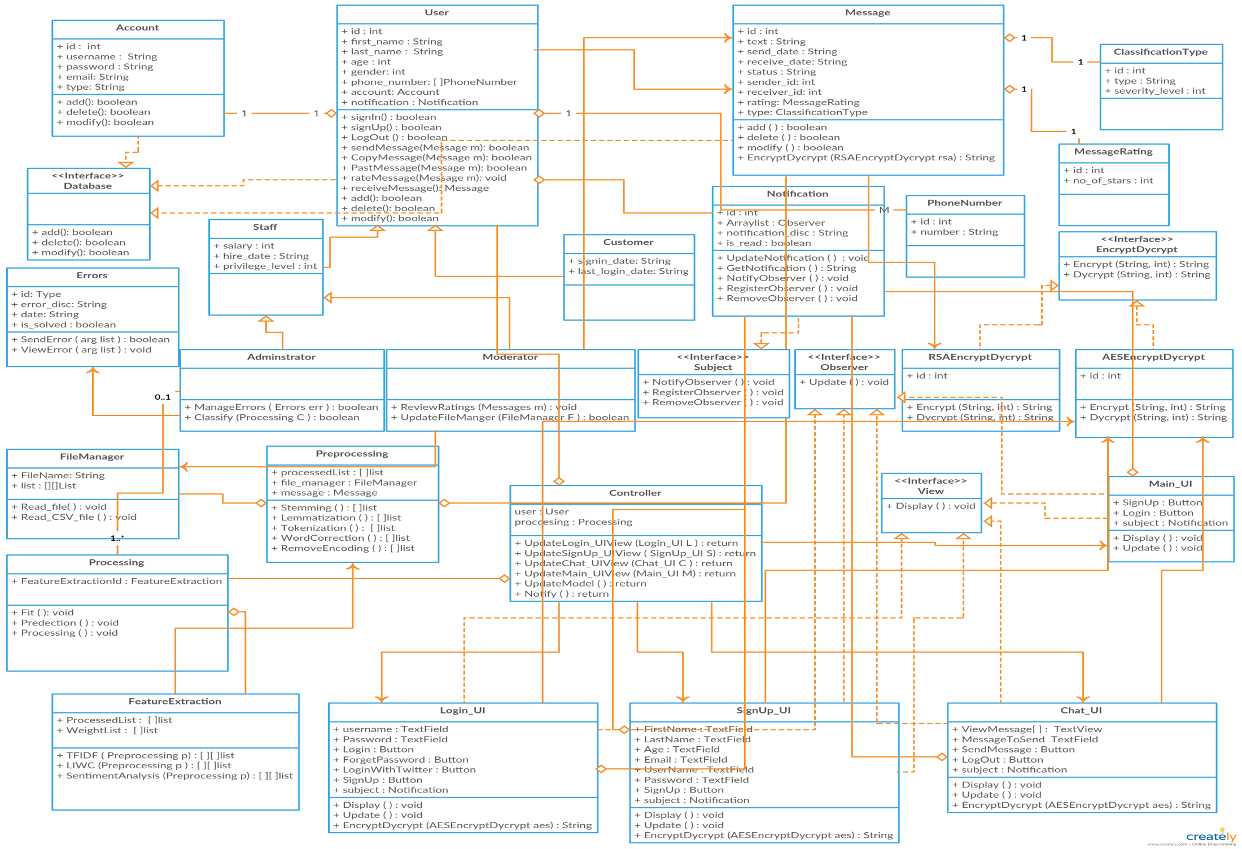
Class Diagram

Slide 22
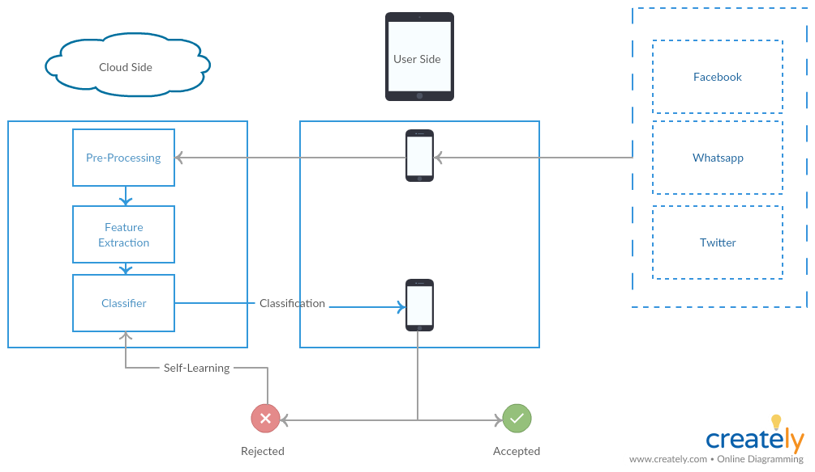



System Overview

Slide 23



Non Functional Requirements
Security
Maintainability
Portability
Have Encryption and Decryption
Self Learning
Both Desktop and Android

Slide 24
Market motivation

Slide 25
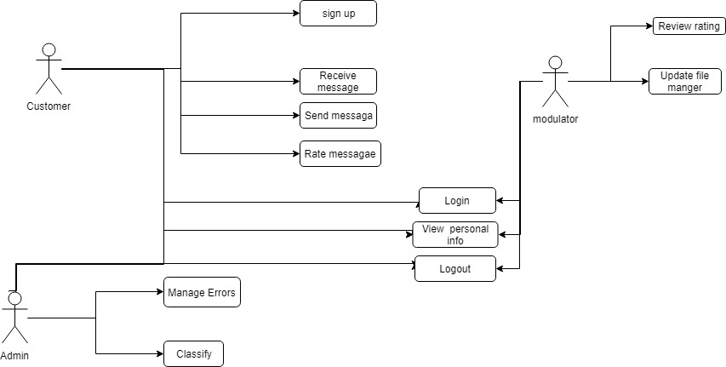
USE Case

Slide 26
Functional Requirement
User | Login with social media Rating
Messages | Send messages & Receive messages Encrypt & Decrypt
Processing | Preprocessing Feature extraction Classification
System | Notify Result Upgrade Classifier

Slide 27
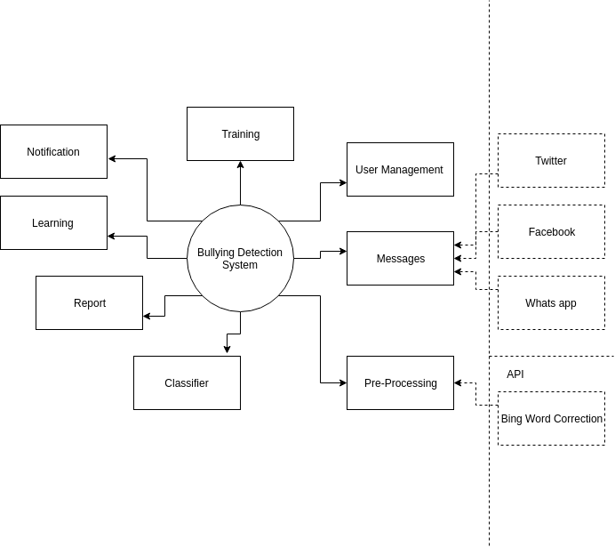
Context Diagram

Slide 28
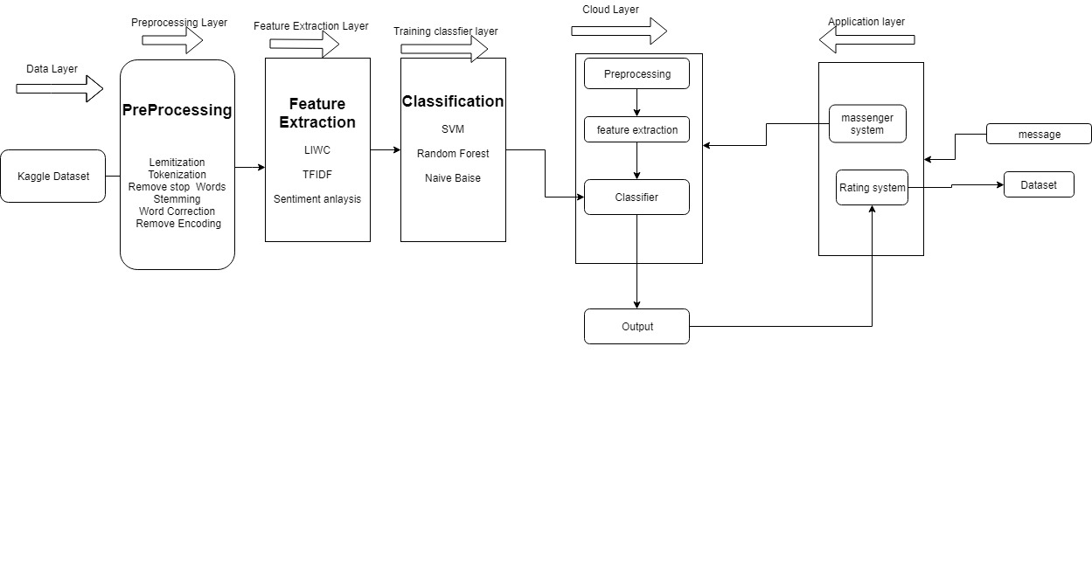
Block diagram

Slide 29
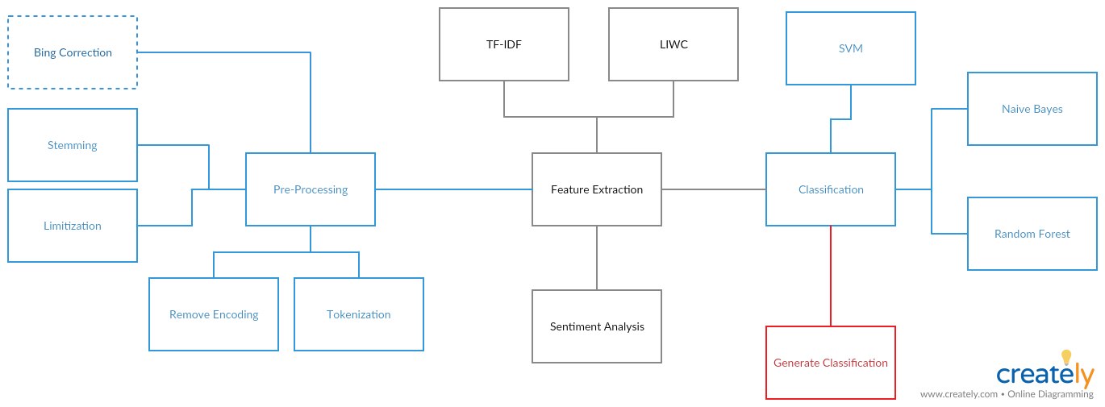
Block diagram

